Slide 1
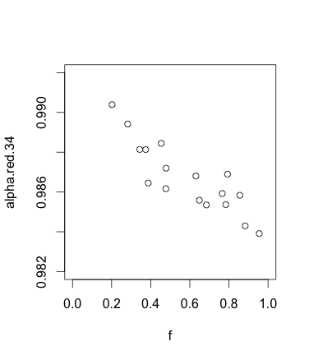
Model R: Reduced S using pooled product Rayleigh

Slide 2
Model R Statistics
Residuals:
Min 1Q Median 3Q Max
-1.599e-03 -4.843e-04 -6.695e-05 6.742e-04 1.521e-03
Coefficients:
Estimate Std. Error t value Pr(>|t|)
(Intercept) 0.9906057 0.0005993 1652.89 < 2e-16 ***
f -0.0065996 0.0009524 -6.93 4.81e-06 ***
---
Signif. codes: 0 ‘***’ 0.001 ‘**’ 0.01 ‘*’ 0.05 ‘.’ 0.1 ‘ ’ 1
Residual standard error: 0.0008781 on 15 degrees of freedom
(16 observations deleted due to missingness)
Multiple R-squared: 0.762, Adjusted R-squared: 0.7461
F-statistic: 48.02 on 1 and 15 DF, p-value: 4.814e-06

Slide 3
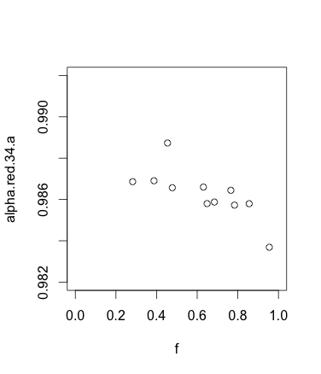
Model RA: Reduced S using sulfite Rayleigh

Slide 4
Model RA Statistics
Residuals:
Min 1Q Median 3Q Max
-0.0011854 -0.0004001 -0.0001610 0.0004143 0.0017061
Coefficients:
Estimate Std. Error t value Pr(>|t|)
(Intercept) 0.9889791 0.0008532 1159.146 < 2e-16 ***
f -0.0042990 0.0012921 -3.327 0.00884 **
---
Signif. codes: 0 ‘***’ 0.001 ‘**’ 0.01 ‘*’ 0.05 ‘.’ 0.1 ‘ ’ 1
Residual standard error: 0.0008533 on 9 degrees of freedom
(22 observations deleted due to missingness)
Multiple R-squared: 0.5516, Adjusted R-squared: 0.5017
F-statistic: 11.07 on 1 and 9 DF, p-value: 0.00884

Slide 5
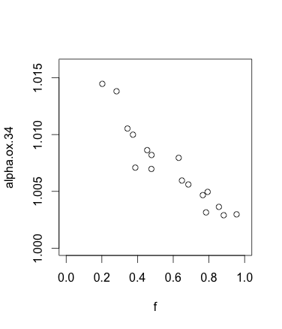
Model O: Oxidized S using pooled product Rayleigh

Slide 6
Model O Statistics
Residuals:
Min 1Q Median 3Q Max
-0.0029289 -0.0004372 -0.0001151 0.0007343 0.0022882
Coefficients:
Estimate Std. Error t value Pr(>|t|)
(Intercept) 1.0155600 0.0008991 1129.47 < 2e-16 ***
f -0.0143032 0.0014288 -10.01 4.93e-08 ***
---
Signif. codes: 0 ‘***’ 0.001 ‘**’ 0.01 ‘*’ 0.05 ‘.’ 0.1 ‘ ’ 1
Residual standard error: 0.001317 on 15 degrees of freedom
(16 observations deleted due to missingness)
Multiple R-squared: 0.8698, Adjusted R-squared: 0.8611
F-statistic: 100.2 on 1 and 15 DF, p-value: 4.928e-08

Slide 7
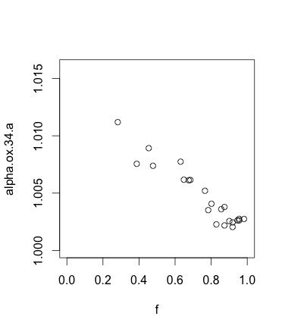
Model OA: Oxidized S using sulfite Rayleigh

Slide 8
Model OA Statistics
Residuals:
Min 1Q Median 3Q Max
-0.0016289 -0.0005926 0.0002054 0.0005456 0.0015204
Coefficients:
Estimate Std. Error t value Pr(>|t|)
(Intercept) 1.0139013 0.0006928 1463.52 < 2e-16 ***
f -0.0121785 0.0008883 -13.71 1.25e-11 ***
---
Signif. codes: 0 ‘***’ 0.001 ‘**’ 0.01 ‘*’ 0.05 ‘.’ 0.1 ‘ ’ 1
Residual standard error: 0.000821 on 20 degrees of freedom
(11 observations deleted due to missingness)
Multiple R-squared: 0.9038, Adjusted R-squared: 0.899
F-statistic: 188 on 1 and 20 DF, p-value: 1.248e-11

Slide 9
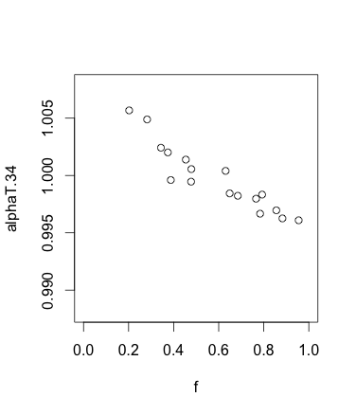
Model T: Total S using pooled product Rayleigh

Slide 10
Model T Statistics
Residuals:
Min 1Q Median 3Q Max
-2.431e-03 -4.304e-04 -8.527e-05 5.793e-04 1.645e-03
Coefficients:
Estimate Std. Error t value Pr(>|t|)
(Intercept) 1.0064849 0.0007368 1365.963 < 2e-16 ***
f -0.0114897 0.0011709 -9.813 6.4e-08 ***
---
Signif. codes: 0 ‘***’ 0.001 ‘**’ 0.01 ‘*’ 0.05 ‘.’ 0.1 ‘ ’ 1
Residual standard error: 0.00108 on 15 degrees of freedom
(16 observations deleted due to missingness)
Multiple R-squared: 0.8652, Adjusted R-squared: 0.8562
F-statistic: 96.29 on 1 and 15 DF, p-value: 6.403e-08

Slide 11
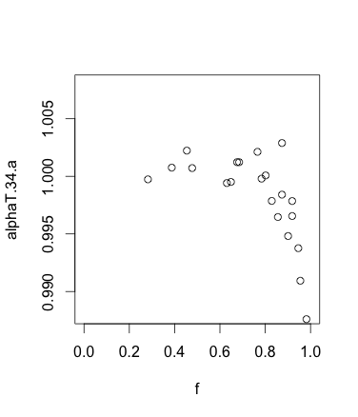
Model TA: Total S using sulfite Rayleigh

Slide 12
Model TA Statistics
Residuals:
Min 1Q Median 3Q Max
-0.0126463 -0.0025426 -0.0001735 0.0012895 0.0350275
Coefficients:
Estimate Std. Error t value Pr(>|t|)
(Intercept) 1.000916 0.007338 136.402 <2e-16 ***
f[2:33] -0.002101 0.009256 -0.227 0.823
---
Signif. codes: 0 ‘***’ 0.001 ‘**’ 0.01 ‘*’ 0.05 ‘.’ 0.1 ‘ ’ 1
Residual standard error: 0.008928 on 21 degrees of freedom
(9 observations deleted due to missingness)
Multiple R-squared: 0.002447, Adjusted R-squared: -0.04506
F-statistic: 0.05151 on 1 and 21 DF, p-value: 0.8226

Slide 13
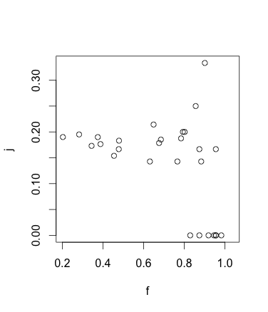
j vs f
0.1875

Slide 14
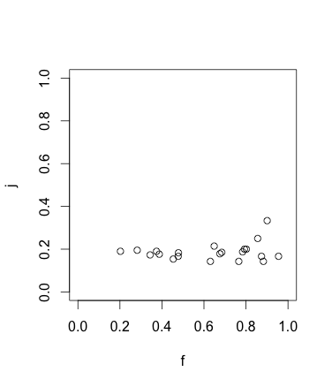
j vs f (removed 0’s)
0.1875

Slide 15
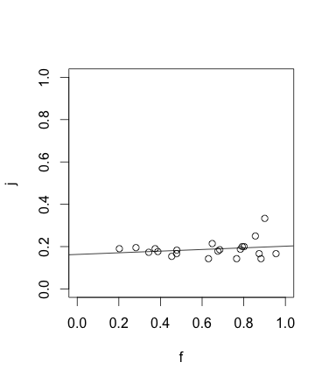
j vs f linear model
(p = 0.82, i.e. looks flat @ 0.1875)

Slide 16
j vs f Statistics
Residuals:
Min 1Q Median 3Q Max
-0.0126463 -0.0025426 -0.0001735 0.0012895 0.0350275
Coefficients:
Estimate Std. Error t value Pr(>|t|)
(Intercept) 1.000916 0.007338 136.402 <2e-16 ***
f[2:33] -0.002101 0.009256 -0.227 0.823
---
Signif. codes: 0 ‘***’ 0.001 ‘**’ 0.01 ‘*’ 0.05 ‘.’ 0.1 ‘ ’ 1
Residual standard error: 0.008928 on 21 degrees of freedom
(9 observations deleted due to missingness)
Multiple R-squared: 0.002447, Adjusted R-squared: -0.04506
F-statistic: 0.05151 on 1 and 21 DF, p-value: 0.8226

Slide 17
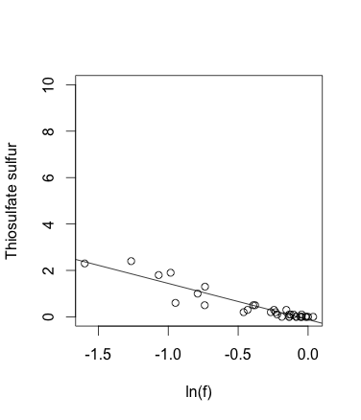
Thiosulfate S vs ln(f)

Slide 18
Thiosulfate S vs ln(f) Statistics
Residuals:
Min 1Q Median 3Q Max
-0.75787 -0.08665 0.02938 0.10473 0.54713
Coefficients:
Estimate Std. Error t value Pr(>|t|)
(Intercept) -0.12402 0.05899 -2.102 0.0437 *
lnf -1.56263 0.10734 -14.558 2.10e-15 ***
---
Signif. codes: 0 ‘***’ 0.001 ‘**’ 0.01 ‘*’ 0.05 ‘.’ 0.1 ‘ ’ 1
Residual standard error: 0.2526 on 31 degrees of freedom
Multiple R-squared: 0.8724, Adjusted R-squared: 0.8683
F-statistic: 211.9 on 1 and 31 DF, p-value: 2.097e-15

Slide 19
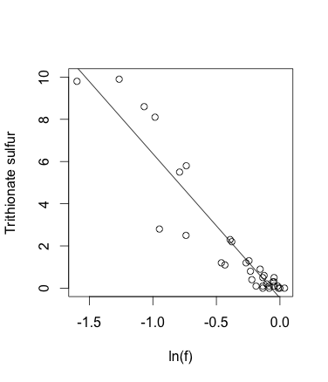
Trithionate S vs ln(f)

Slide 20
Trithionate S vs ln(f) Statistics
Residuals:
Min 1Q Median 3Q Max
-3.2186 -0.3561 0.0851 0.4506 1.8452
Coefficients:
Estimate Std. Error t value Pr(>|t|)
(Intercept) -0.4657 0.2448 -1.903 0.0664 .
lnf -6.8376 0.4453 -15.354 4.89e-16 ***
---
Signif. codes: 0 ‘***’ 0.001 ‘**’ 0.01 ‘*’ 0.05 ‘.’ 0.1 ‘ ’ 1
Residual standard error: 1.048 on 31 degrees of freedom
Multiple R-squared: 0.8838, Adjusted R-squared: 0.88
F-statistic: 235.7 on 1 and 31 DF, p-value: 4.892e-16

Slide 21
Model R vs RA
RedAll$model: 0
f alpha.red.34 model
Min. :0.2025 Min. : 0.9837 Min. :0
1st Qu.:0.6554 1st Qu.: 0.9858 1st Qu.:0
Median :0.8423 Median : 0.9859 Median :0
Mean :0.7585 Mean : 0.9859 Mean :0
3rd Qu.:0.9189 3rd Qu.: 0.9866 3rd Qu.:0
Max. :1.0000 Max. : 0.9869 Max. :0
NA's :3.0000 NA's :24.0000
----------------------------------------------------------------------------
RedAll$model: 1
f alpha.red.34 model
Min. :0.2025 Min. : 0.9839 Min. :1
1st Qu.:0.6554 1st Qu.: 0.9855 1st Qu.:1
Median :0.8423 Median : 0.9862 Median :1
Mean :0.7585 Mean : 0.9864 Mean :1
3rd Qu.:0.9189 3rd Qu.: 0.9870 3rd Qu.:1
Max. :1.0000 Max. : 0.9904 Max. :1
NA's :3.0000 NA's :18.0000

Slide 22
Model R vs RA ANCOVA
Analysis of Variance Table
Response: RedAll$alpha.red.34
Df Sum Sq Mean Sq F value Pr(>F)
RedAll$f 1 3.2042e-05 3.2042e-05 49.9667 7.463e-07 ***
RedAll$model 1 5.8000e-08 5.8000e-08 0.0903 0.7669
RedAll$f:RedAll$model 1 6.9800e-07 6.9800e-07 1.0889 0.3092
Residuals 20 1.2825e-05 6.4100e-07
---
Signif. codes: 0 ‘***’ 0.001 ‘**’ 0.01 ‘*’ 0.05 ‘.’ 0.1 ‘ ’ 1

Slide 23
Model O vs OA
OxAll$model: 0
f alpha.ox.34 model
Min. :0.2025 Min. : 1.002 Min. :0
1st Qu.:0.6554 1st Qu.: 1.003 1st Qu.:0
Median :0.8423 Median : 1.004 Median :0
Mean :0.7585 Mean : 1.004 Mean :0
3rd Qu.:0.9189 3rd Qu.: 1.006 3rd Qu.:0
Max. :1.0000 Max. : 1.008 Max. :0
NA's :3.0000 NA's :13.000
----------------------------------------------------------------------------
OxAll$model: 1
f alpha.ox.34 model
Min. :0.2025 Min. : 1.003 Min. :1
1st Qu.:0.6554 1st Qu.: 1.004 1st Qu.:1
Median :0.8423 Median : 1.006 Median :1
Mean :0.7585 Mean : 1.007 Mean :1
3rd Qu.:0.9189 3rd Qu.: 1.008 3rd Qu.:1
Max. :1.0000 Max. : 1.014 Max. :1
NA's :3.0000 NA's :18.000

Slide 24
Model O vs OA ANCOVA
Analysis of Variance Table
Response: OxAll$alpha.ox.34
Df Sum Sq Mean Sq F value Pr(>F)
OxAll$f 1 2.4047e-04 2.4047e-04 235.4137 4.988e-16 ***
OxAll$model 1 4.2800e-07 4.2800e-07 0.4192 0.5221
OxAll$f:OxAll$model 1 1.5300e-06 1.5300e-06 1.4980 0.2302
Residuals 31 3.1665e-05 1.0210e-06
---
Signif. codes: 0 ‘***’ 0.001 ‘**’ 0.01 ‘*’ 0.05 ‘.’ 0.1 ‘ ’ 1

Slide 25
Model T vs TA
TotAll$model: 0
f alphaT.34 model
Min. :0.2025 Min. : -Inf Min. :0
1st Qu.:0.6554 1st Qu.: 0.9948 1st Qu.:0
Median :0.8423 Median : 0.9984 Median :0
Mean :0.7585 Mean : -Inf Mean :0
3rd Qu.:0.9189 3rd Qu.: 1.0007 3rd Qu.:0
Max. :1.0000 Max. : 1.0029 Max. :0
NA's :3.0000 NA's :12.0000
----------------------------------------------------------------------------
TotAll$model: 1
f alphaT.34 model
Min. :0.2025 Min. : 0.9961 Min. :1
1st Qu.:0.6554 1st Qu.: 0.9975 1st Qu.:1
Median :0.8423 Median : 0.9984 Median :1
Mean :0.7585 Mean : 0.9993 Mean :1
3rd Qu.:0.9189 3rd Qu.: 1.0005 3rd Qu.:1
Max. :1.0000 Max. : 1.0057 Max. :1
NA's :3.0000 NA's :18.0000

Slide 26
Model T vs TA ANCOVA
Analysis of Variance Table
Response: TotAll$alphaT.34
Df Sum Sq Mean Sq F value Pr(>F)
TotAll$f 1 2.5849e-04 2.5849e-04 30.6903 4.567e-06
***
TotAll$model 1 2.0840e-06 2.0840e-06 0.2474 0.6224
TotAll$f:TotAll$model 1 1.5434e-05 1.5434e-05 1.8324 0.1856
Residuals 31 2.6110e-04 8.4230e-06
---
Signif. codes: 0 ‘***’ 0.001 ‘**’ 0.01 ‘*’ 0.05 ‘.’ 0.1 ‘ ’ 1

